Slide 1


By
Laith Zayed Mahmoud Zayed
Supervisor

Slide 2
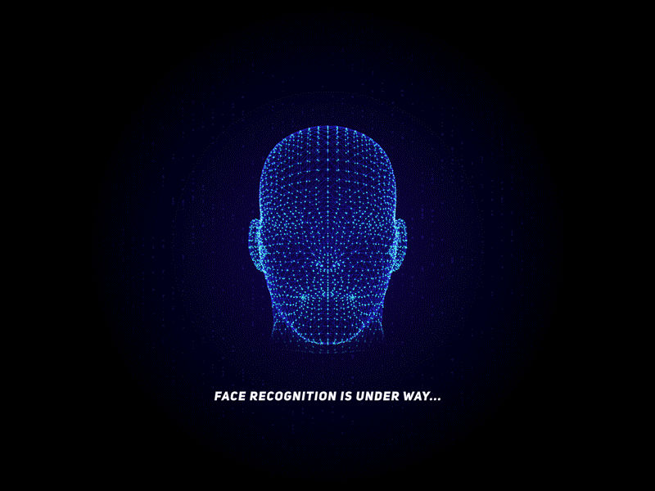
Attendance by using artificial intelligence
and face recognition.

Slide 3
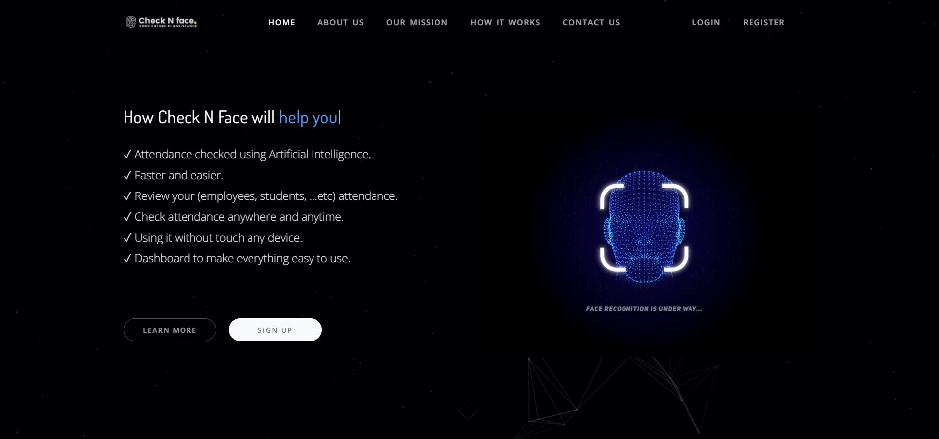

Slide 4
Description
In this highly accelerated world with increased number of people in an unpredicted way, we need always a new system to check people attendance to their work, universities, schools...etc.
we plan to take a good challenge in our market to make a new system that can check attendance without need any special device either your used camera, like laptops and so on. This new technology using Artificial Intelligence, face recognition , and convolutional neural network to predict and choose what is the user person name and time of check-in or check-out depend on their faces was matched with saved data by management system in our database.
Also, you can review all of this data easily, fastly and accurately anytime and anywhere.

Slide 5
Purpose
Provide attendance system with face recognition

Slide 6
Kinds of users
01
02
03
Admin
user
Add, Edit, View and delete users.
Record their attendance (Check-in and Check-out)
Vistor
Request a Demo
Contact-us by form.

Slide 7
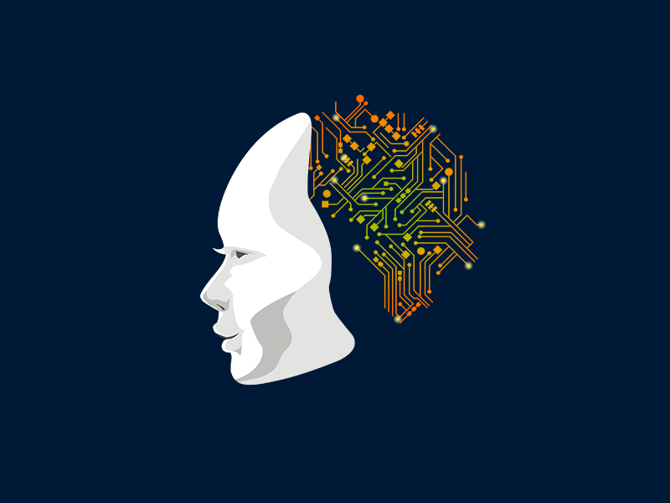
AI will help human being in the near future.

Slide 8
Features
1- Posting (adding) new users by admin.
2- Edit, view and delete users by admin.
3- Encoding for users images to let machine work better with face recognition.
4- Check-in using face recognition.
5- Check-out using face recognition.
6- View users date checked-in and check-out date and time using dashboard with tables.
7- Normal visitor can request a demo and contact us by connected form with dashboard.

Slide 9
The journey four our attendance system by time

Slide 10
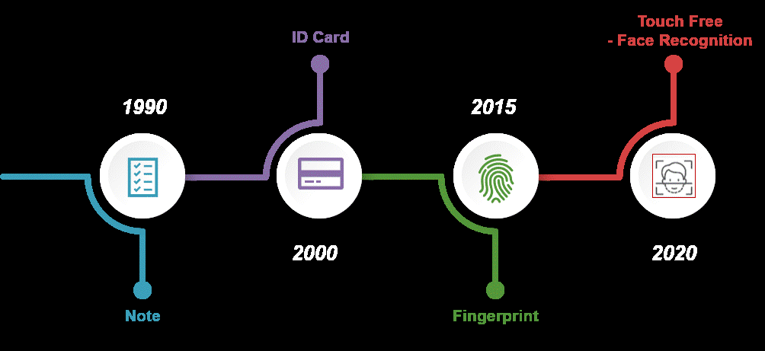

Slide 11
How it works

Slide 12
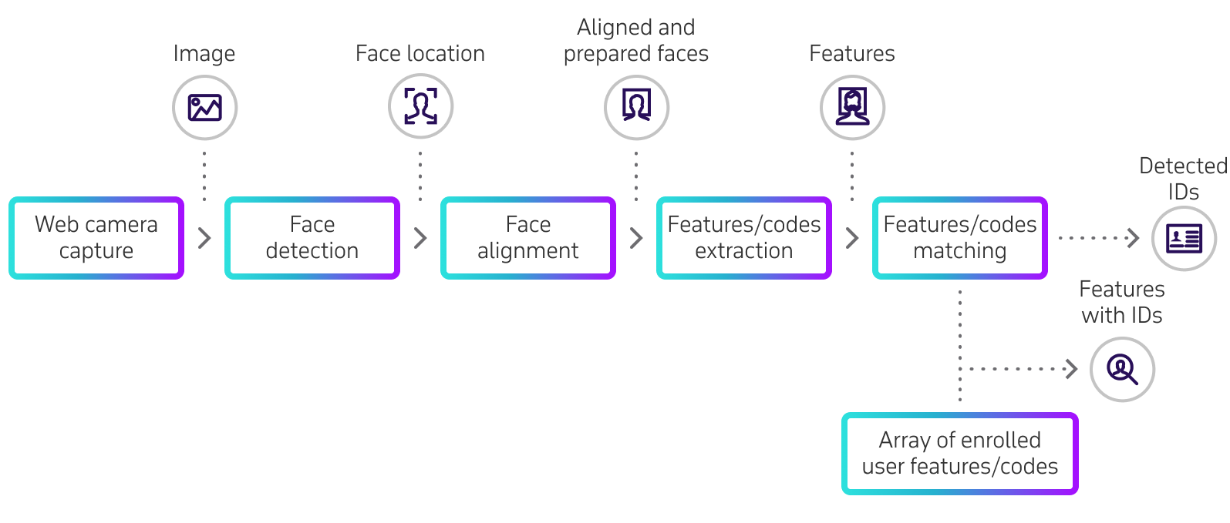

Slide 13






Technologies

Slide 14
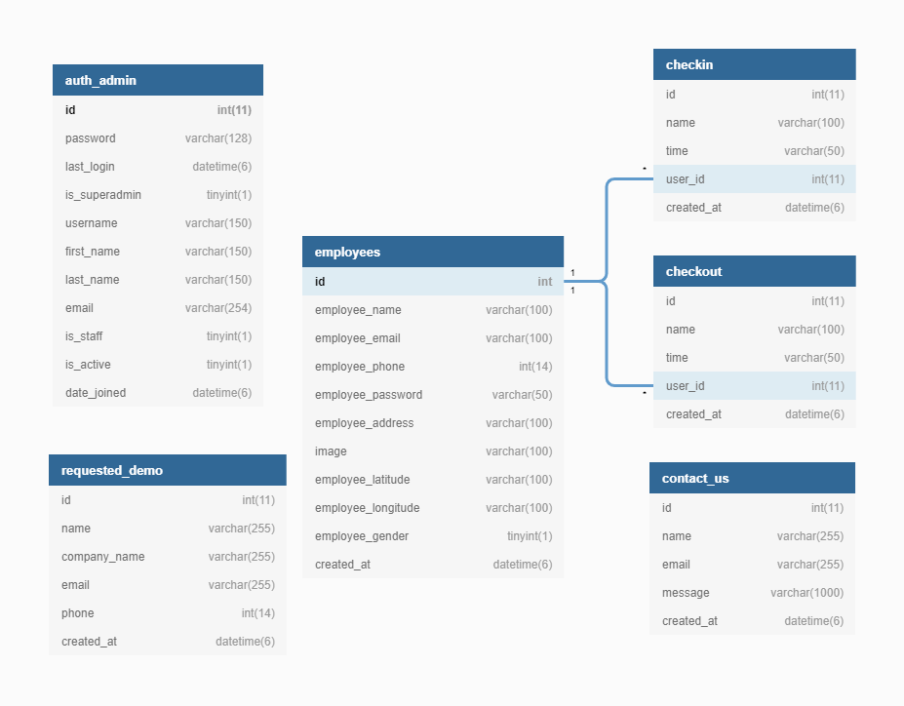
Database Diagram

Slide 15
—Albert Einstein
“ The measure of intelligence is the ability to change “

Slide 16
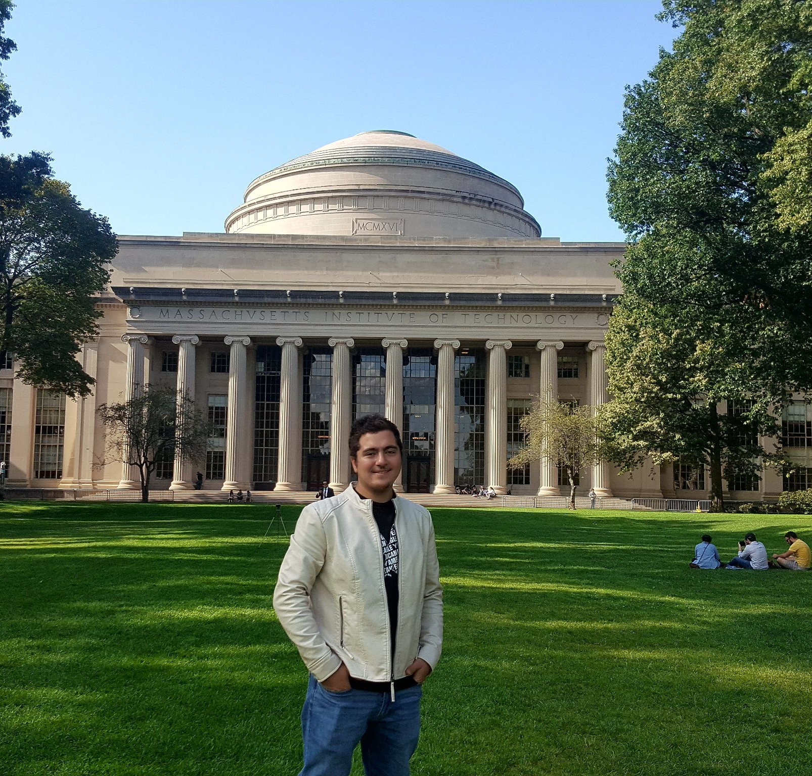
Project Team
Laith Zayed

Slide 17

Thank You

